Slide 1

Introduction in Mobile UX Design

Slide 2

Liliya Karakoleva
Senior UX Designer,
ASP.NET AJAX,
Telerik

Slide 3
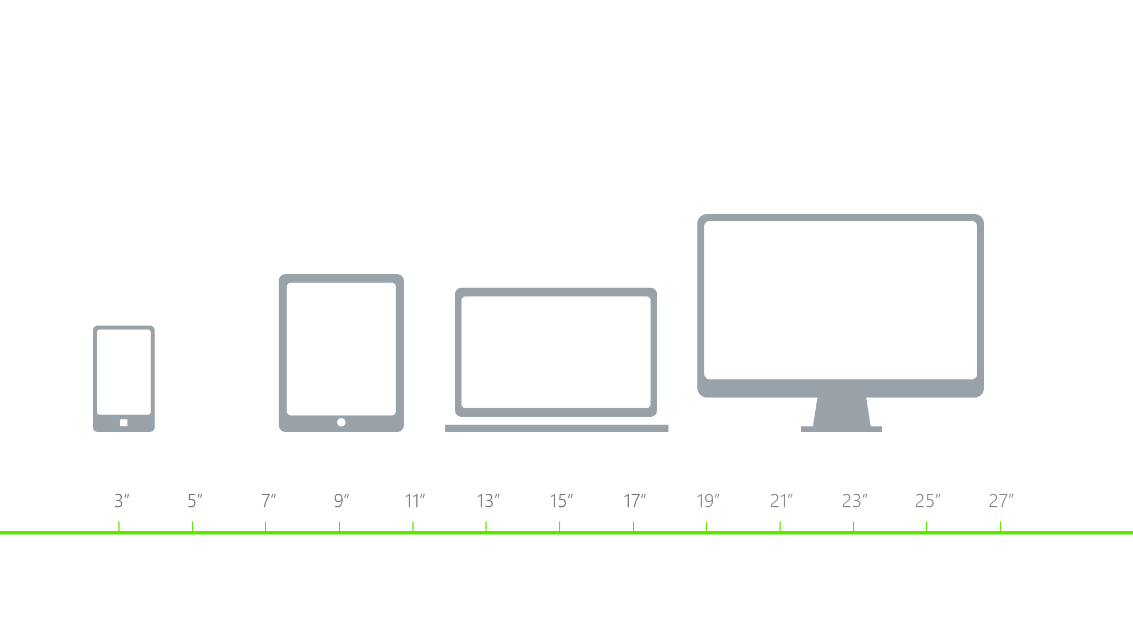
Device Sizes and Resolutions

Slide 4
Mobile Devices
Talking about mobile devices we are not talking about desktop and smartphone.
We are talking about different form factors and device specifications.

Slide 5
Designing mobile
what is our target audience?
what kind of device are they using?
how do the user and the device interact with each other?

Slide 6
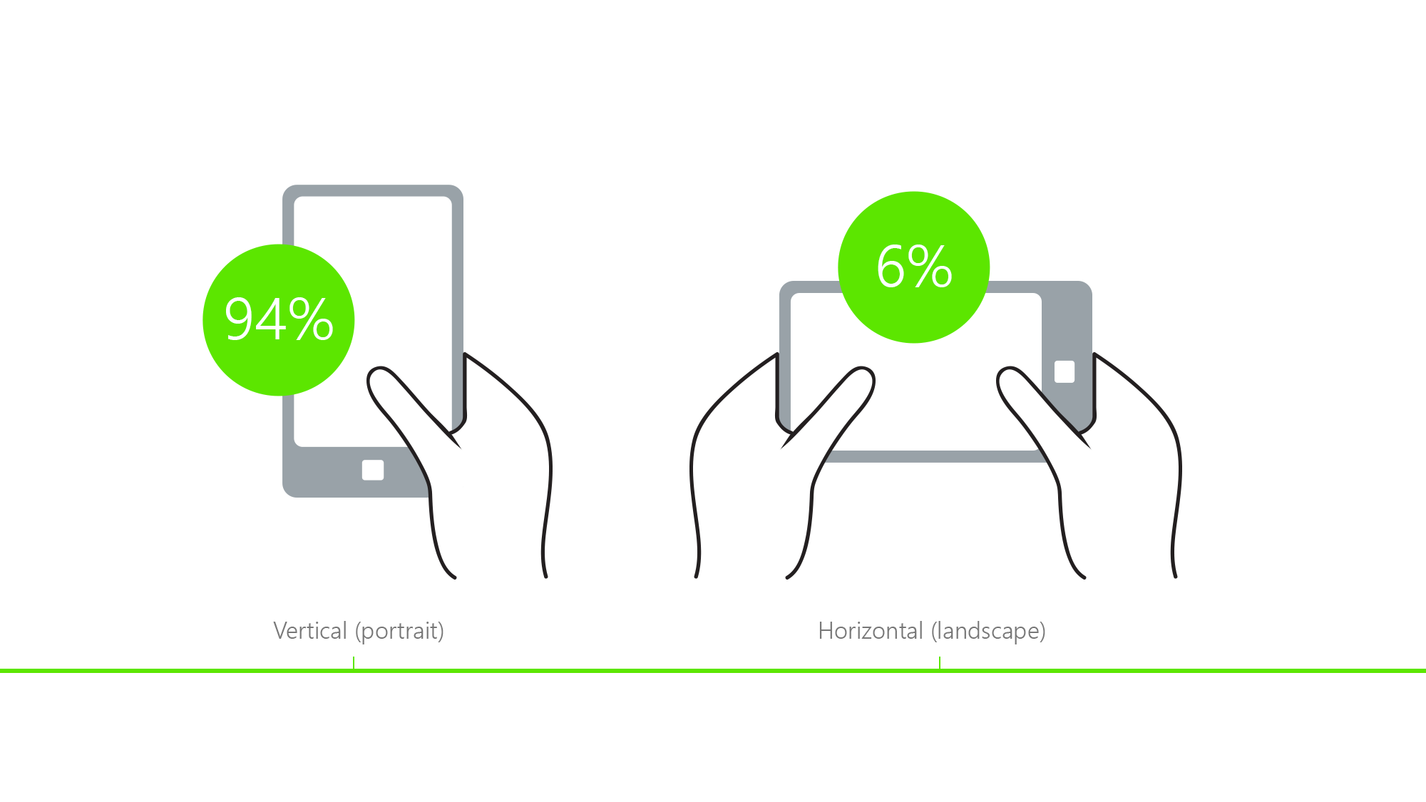
Global Smartphone Orientation

Slide 7
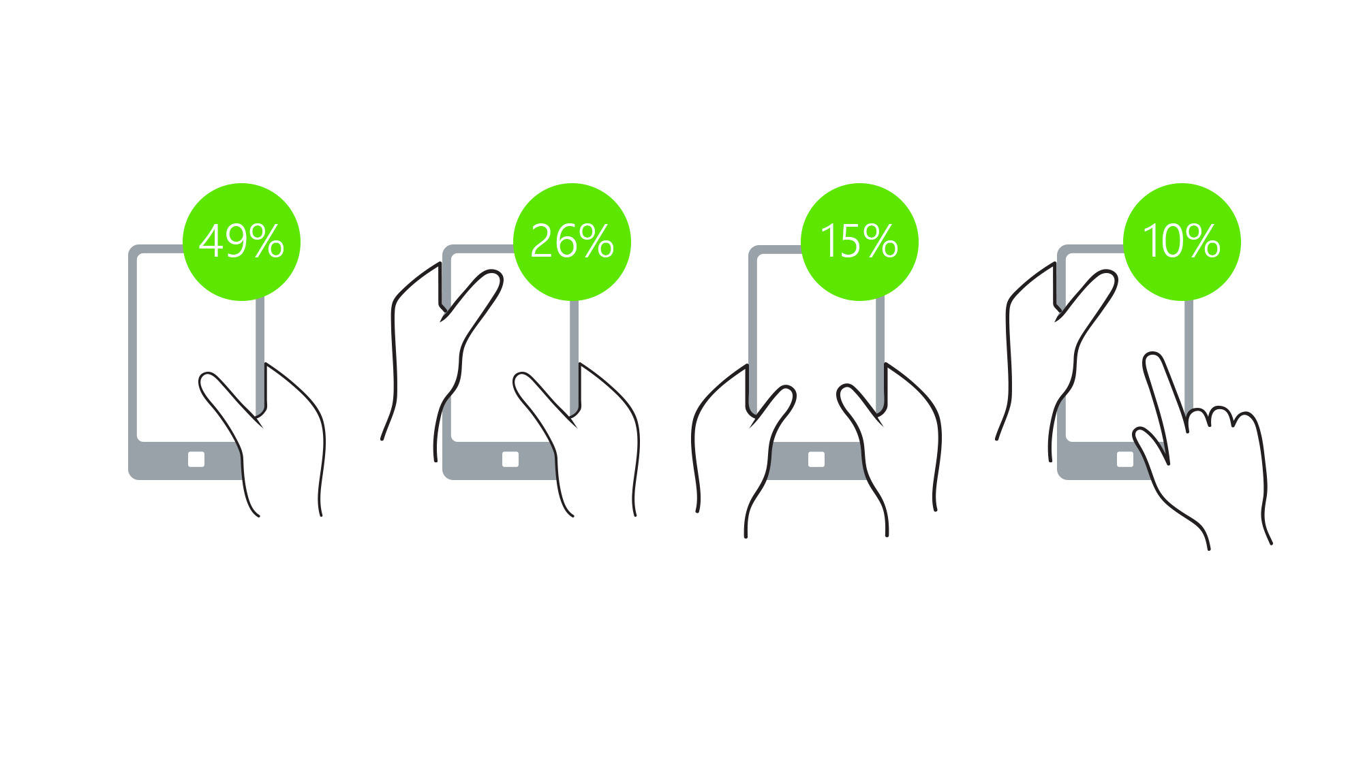
Smartphone Posture

Slide 8

Conclusion
4-5.5”
Portrait Orientation
One-thumb Use

Slide 9
We are designing for human beings, we are not designing for devices.

Slide 10
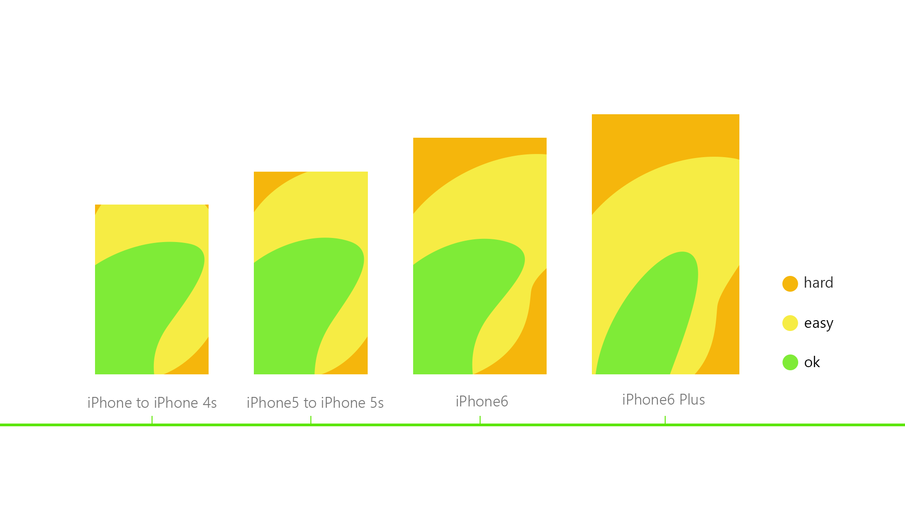
Comfortable zones of interactions

Slide 11
Touch Target Size
Graphical User Interface (GUI) – precise interaction with keyboard and mouse – sense of sight;
Touch User Interface (TUI) – we are using our hands - sense of touch;
large enough target size – adjustment of the touch zone and the size of the controls used in the interface

Slide 12
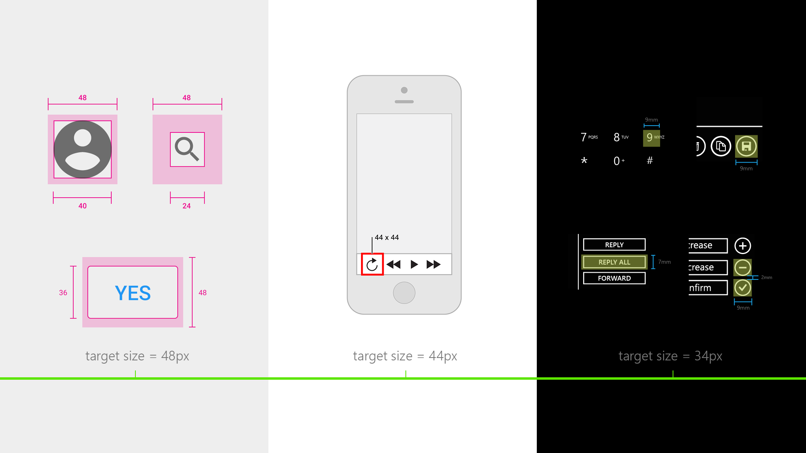
Android
iOS
Windows

Slide 13
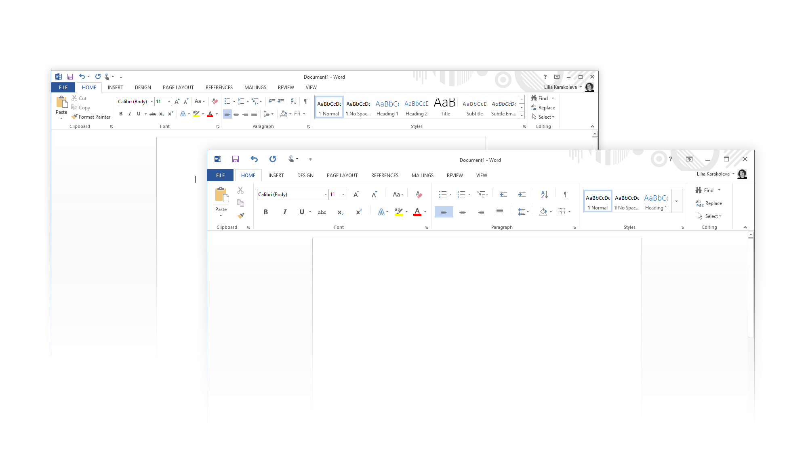
Touchable Controls

Slide 14
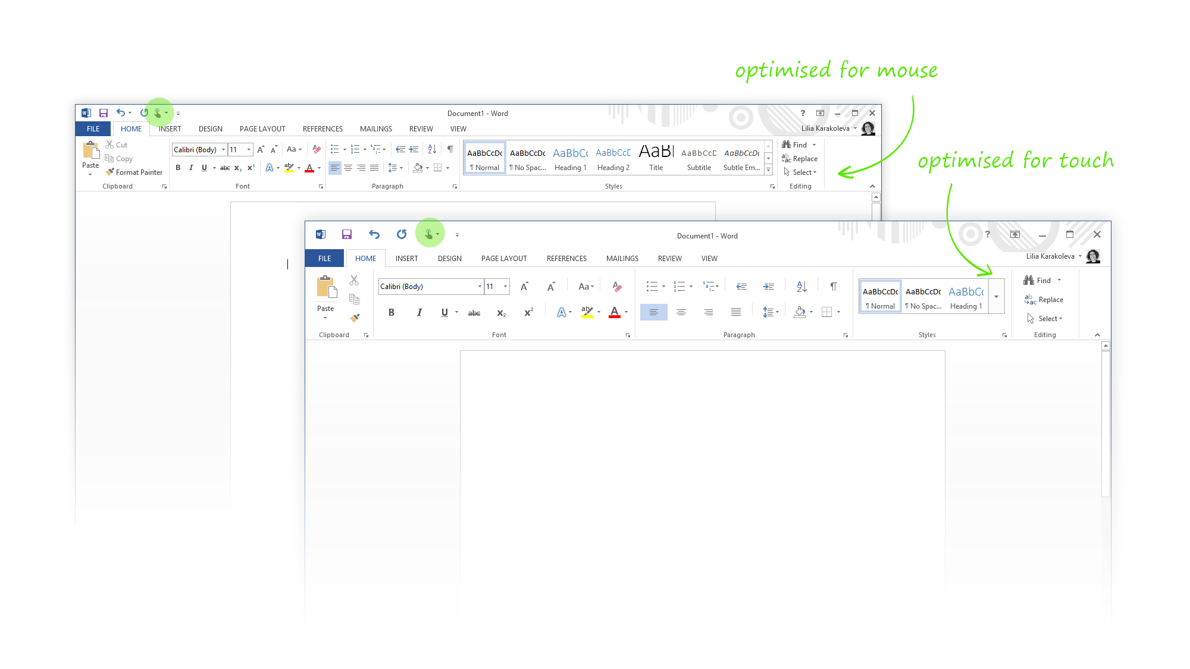
Touchable Controls

Slide 15
Gestures
we communicate with people through gestures;
gestures are invisible by default;
avoid using too complicated combinations – multi-figures gestures;
be sure target size is large enough to avoid mistakes;

Slide 16
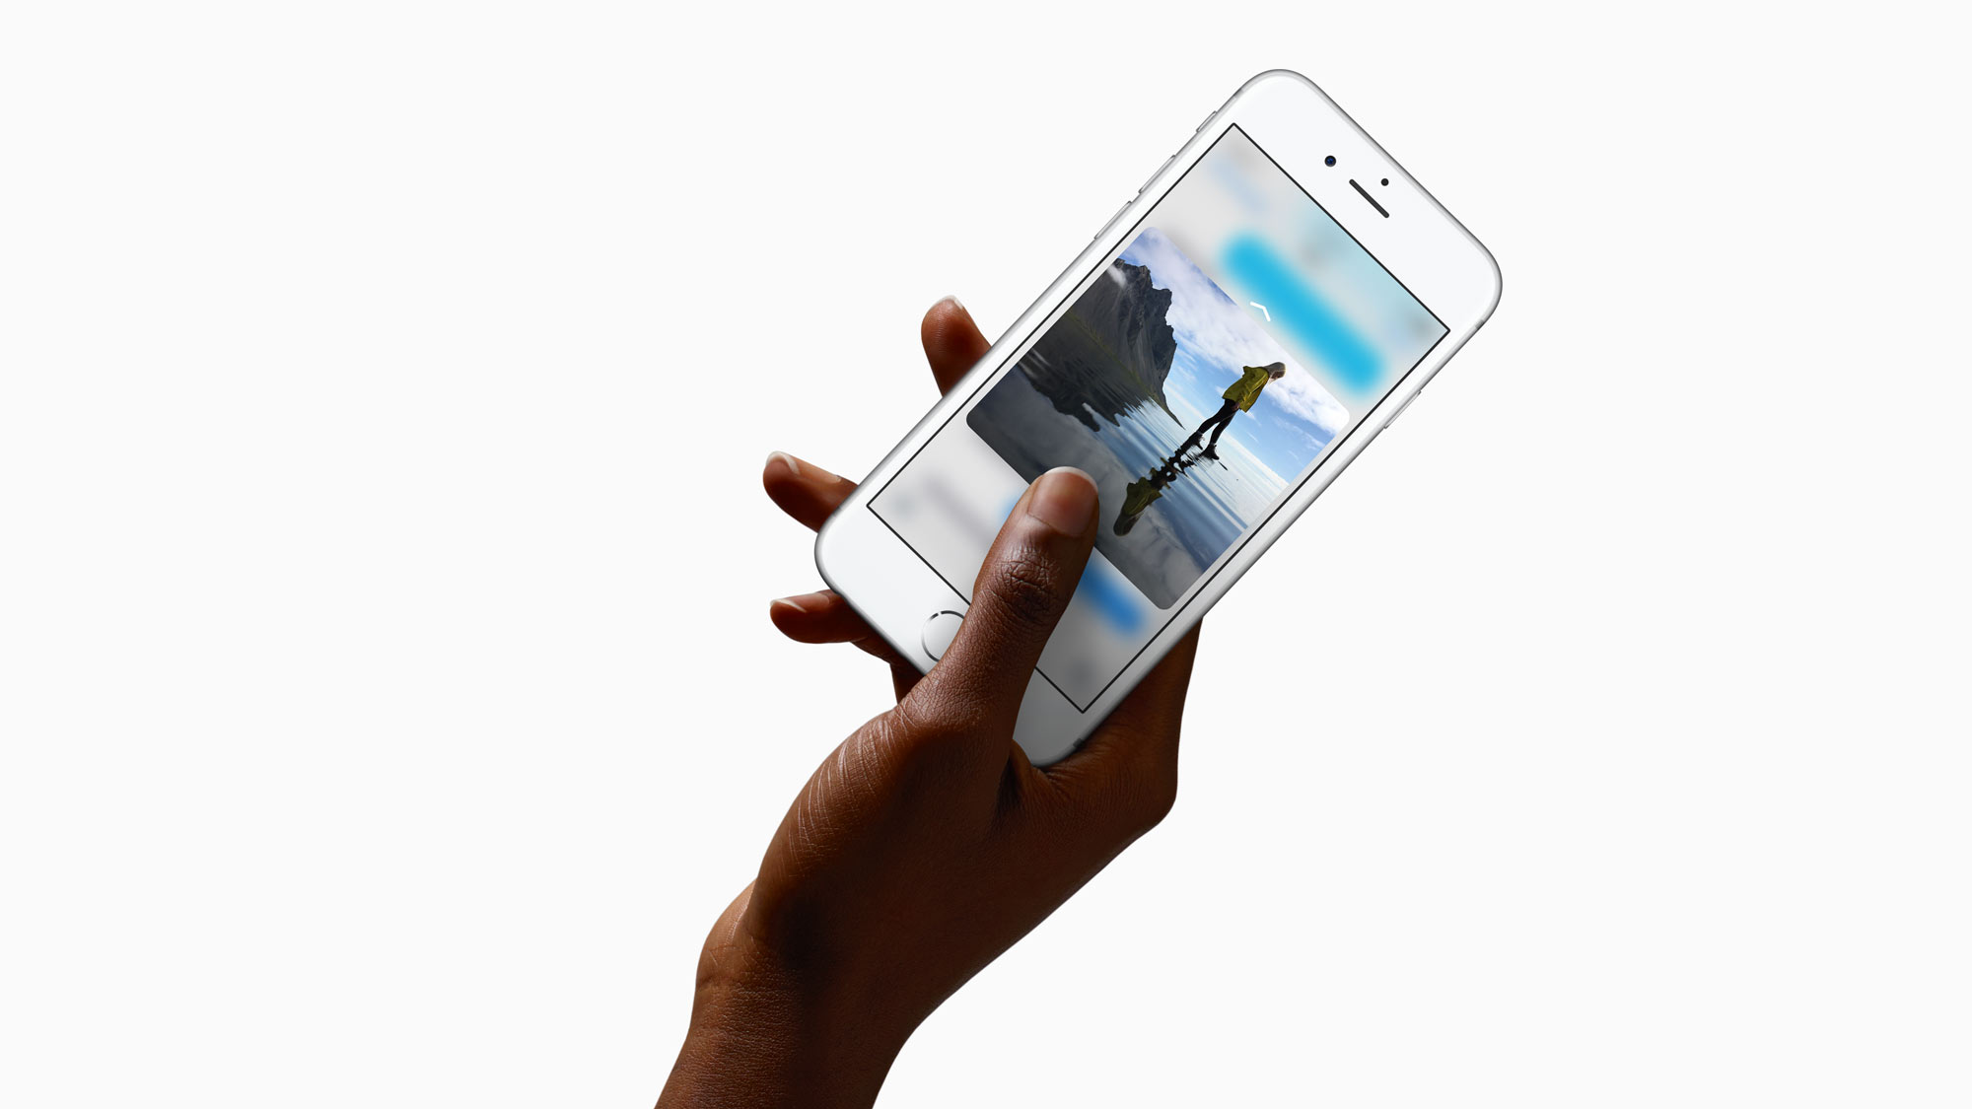
3D Touch Gestures
Peek and Pop

Slide 17
Native vs Web Apps
It is not needed to separate them. Both should follow best mobile design practices. Things in common for native and web apps are:
user;
web browser

Slide 18
Mobile First
Start designing for the small target form factor and increase the content to the large-scaled screen.

Slide 19
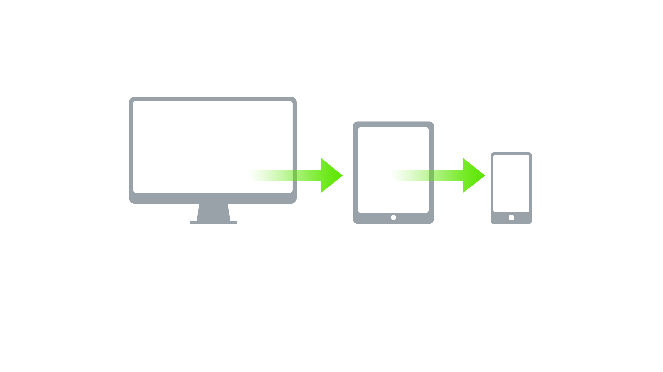
Reduce the Content

Slide 20
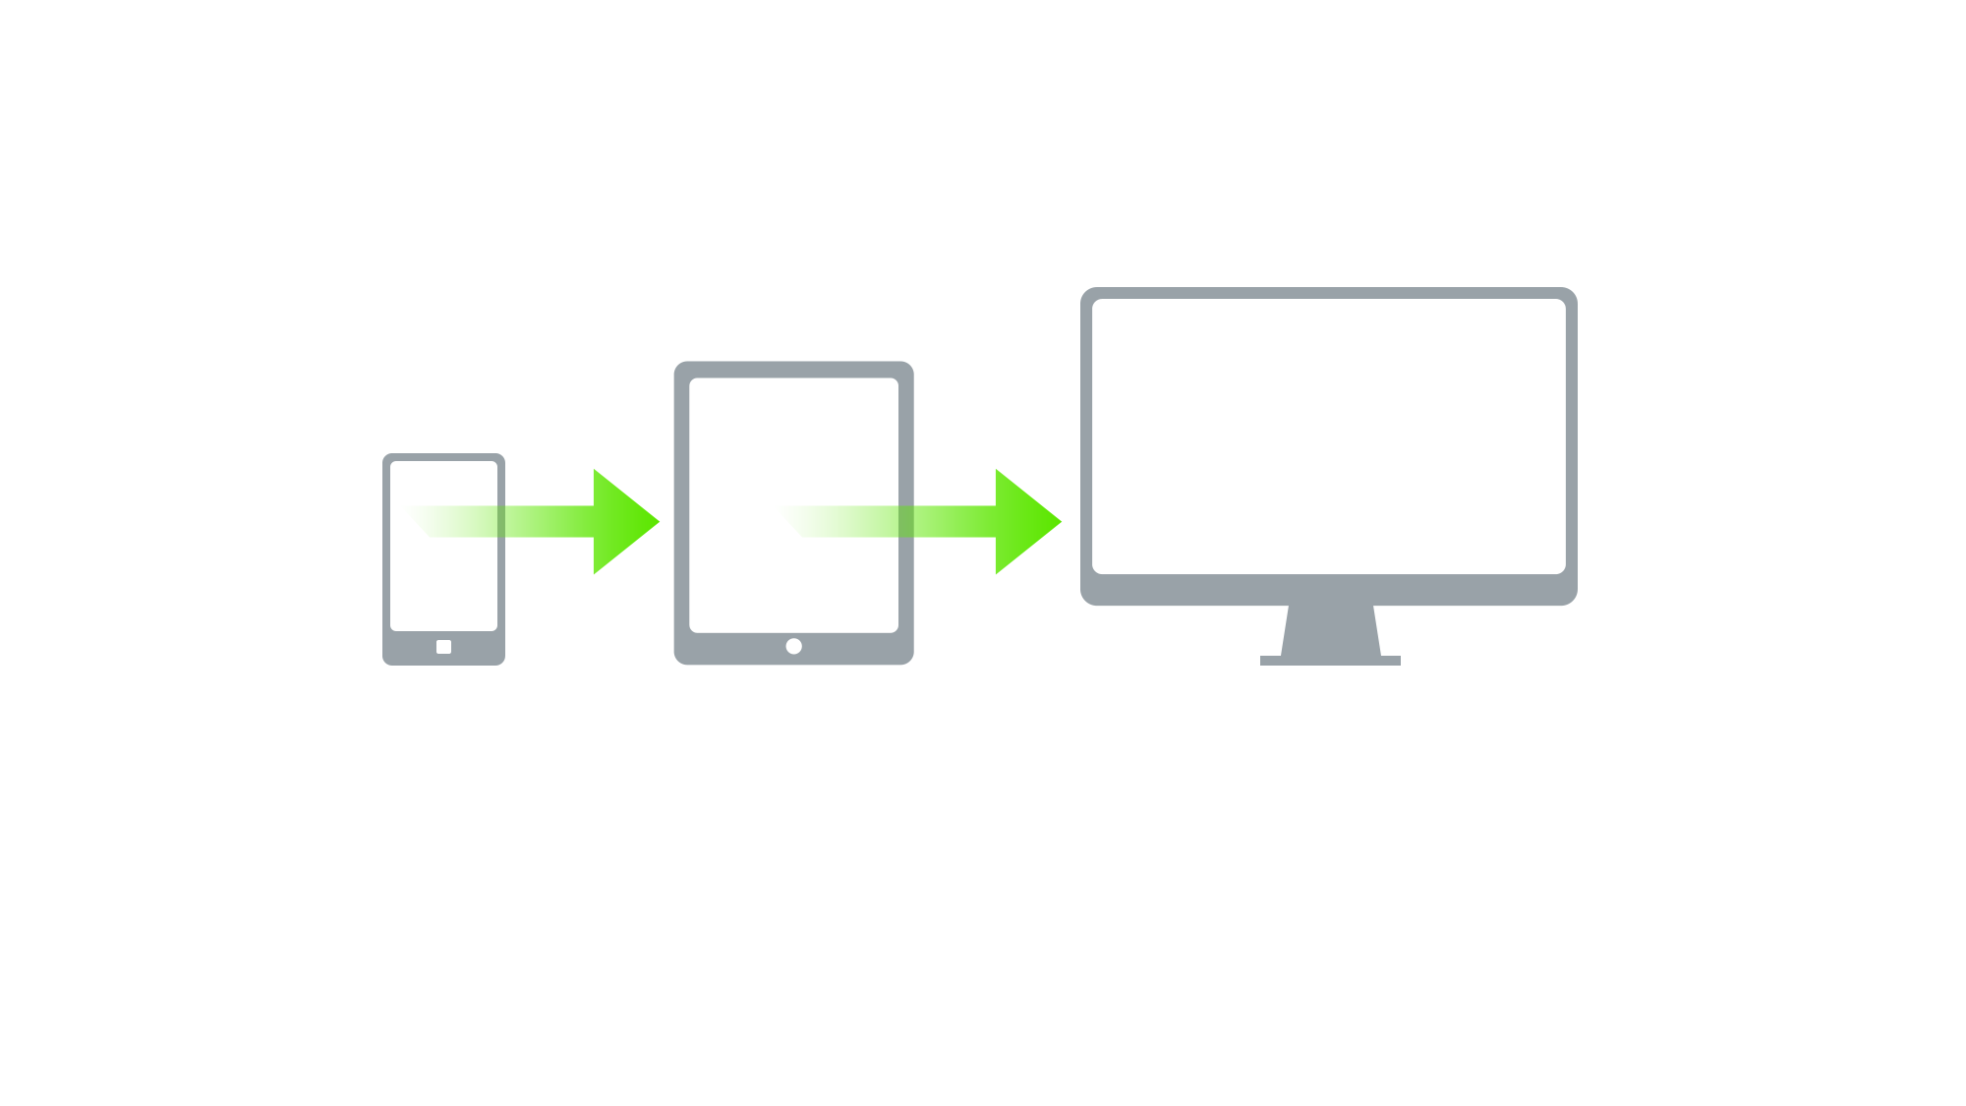
Increase the Content

Slide 21
Mobile First
user-centric design
filter the essential part and features of a project;
focus on vital elements of the content
explore and innovate

Slide 22
RadEditor Mobile Rendering

Slide 23
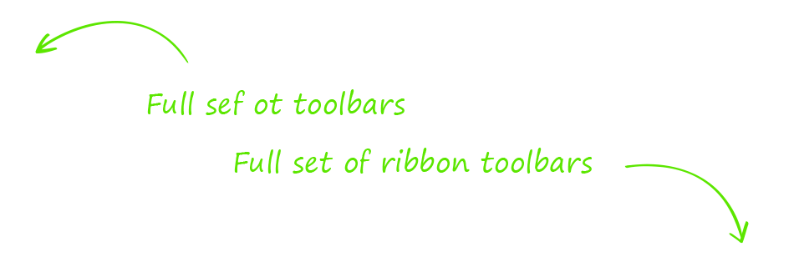
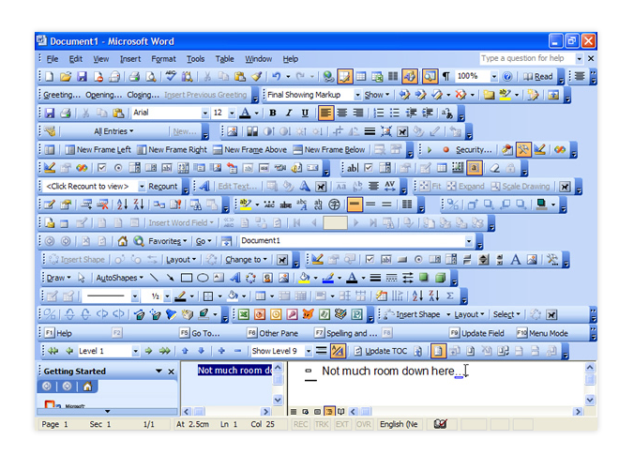
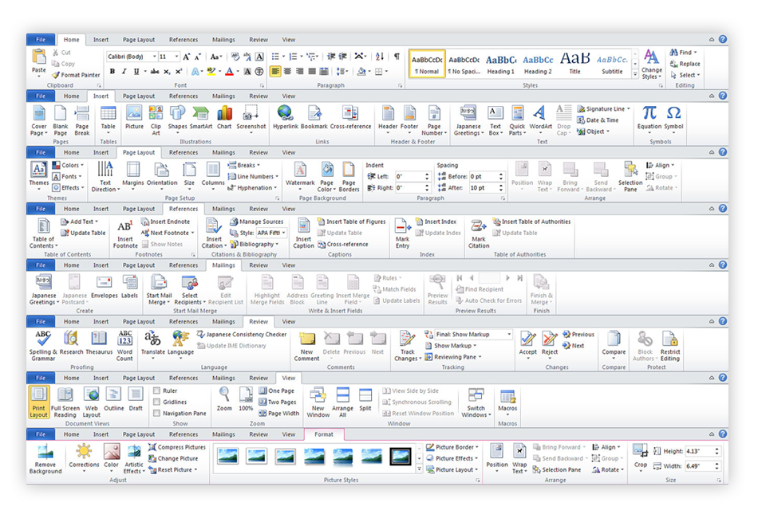
Word Microsoft Office

Slide 24
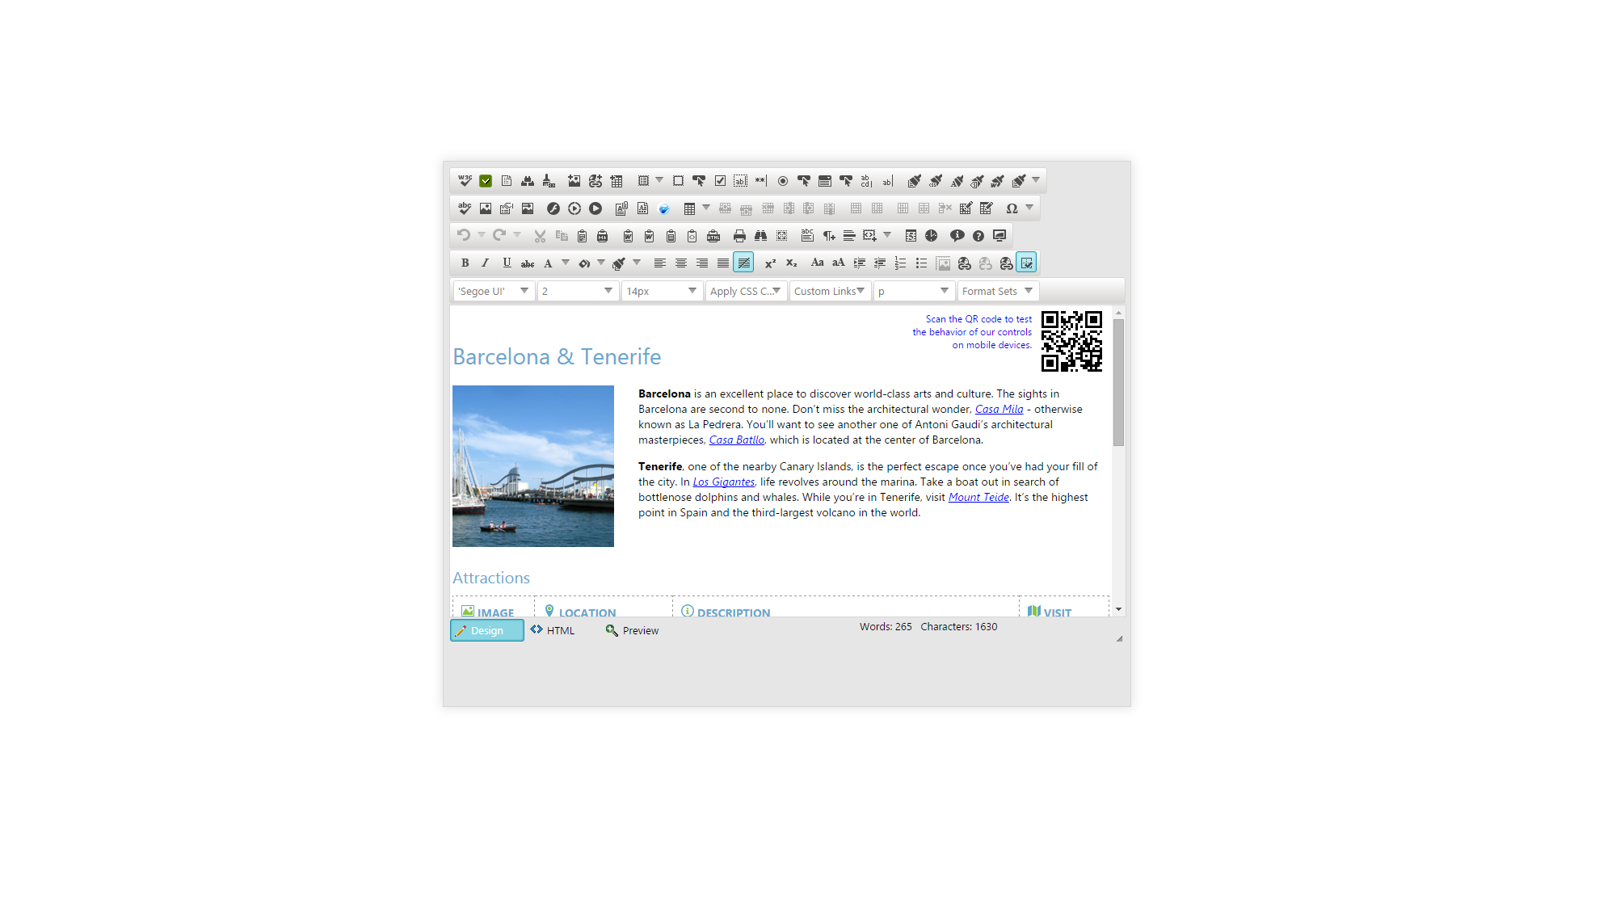
WYSIWUG

Slide 25
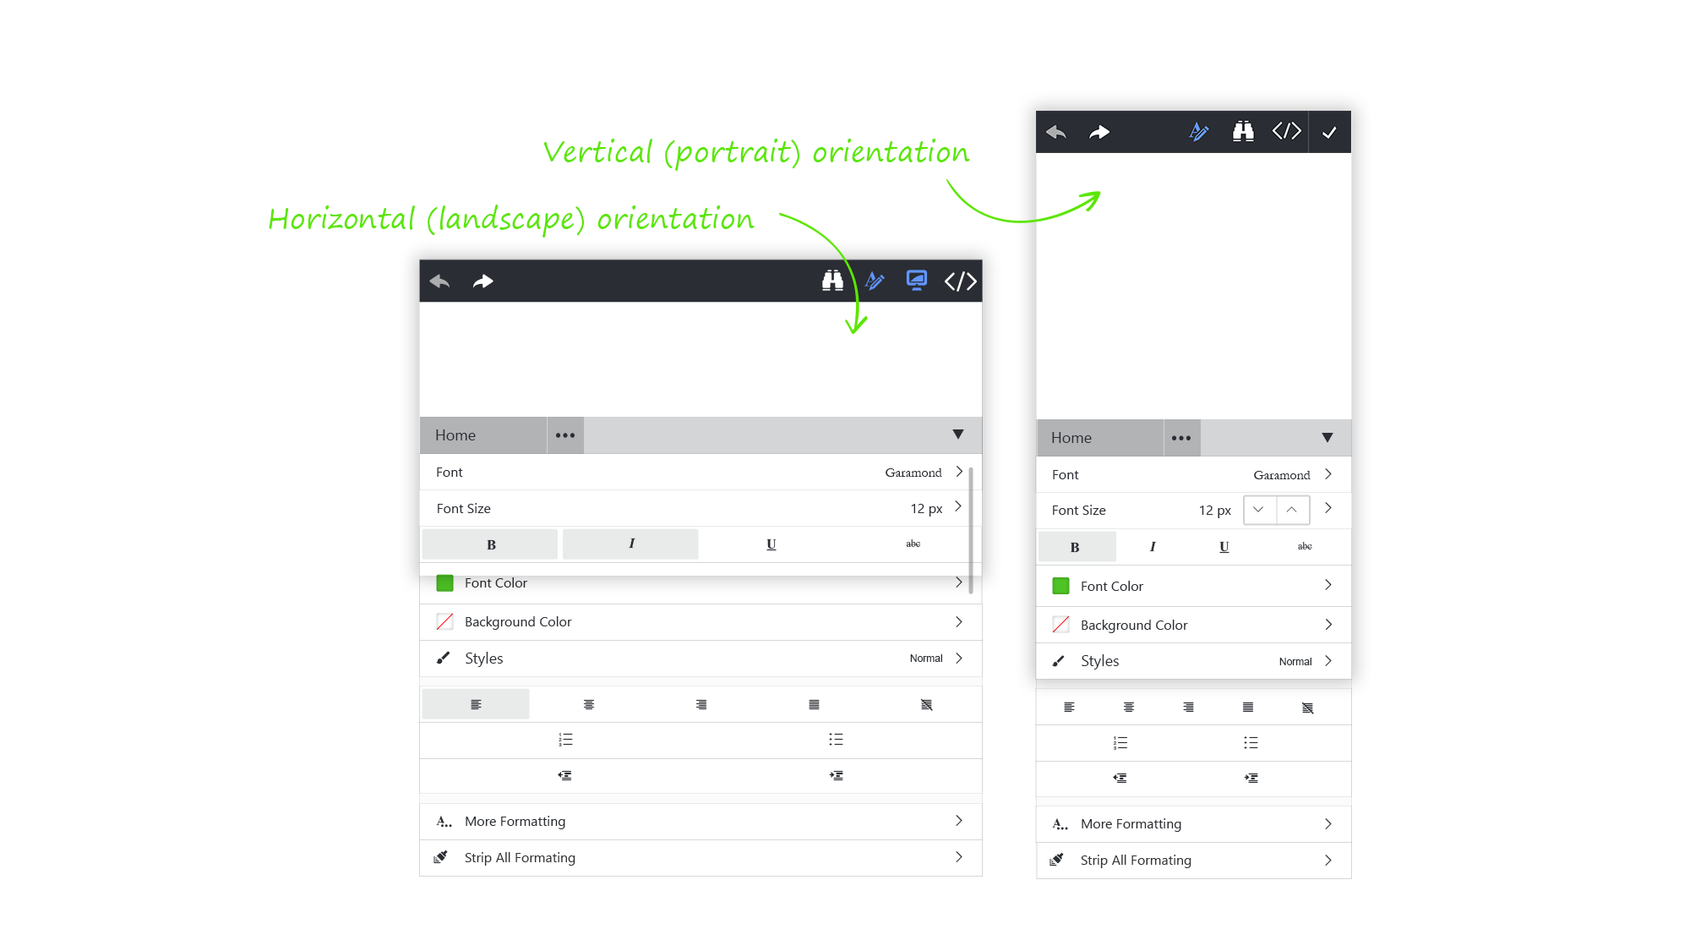
Smartphone Optimization

Slide 26
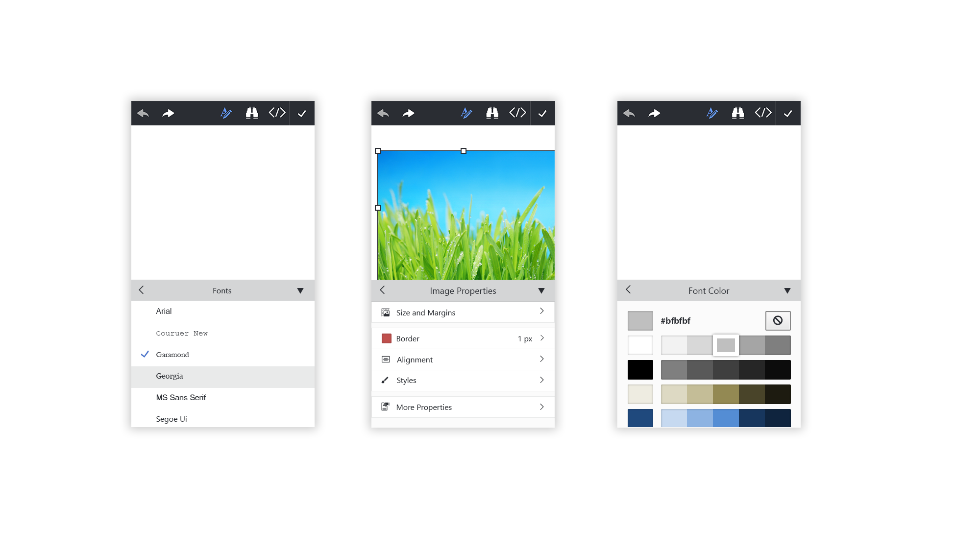

Slide 27
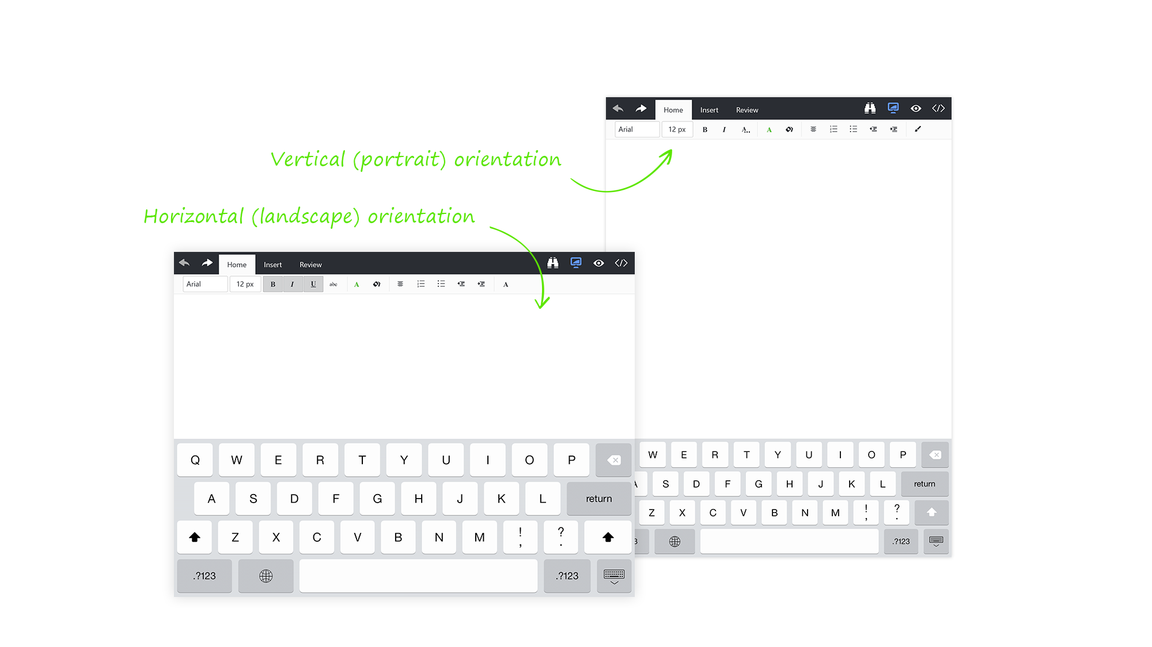
Tablet Optimization

Slide 28
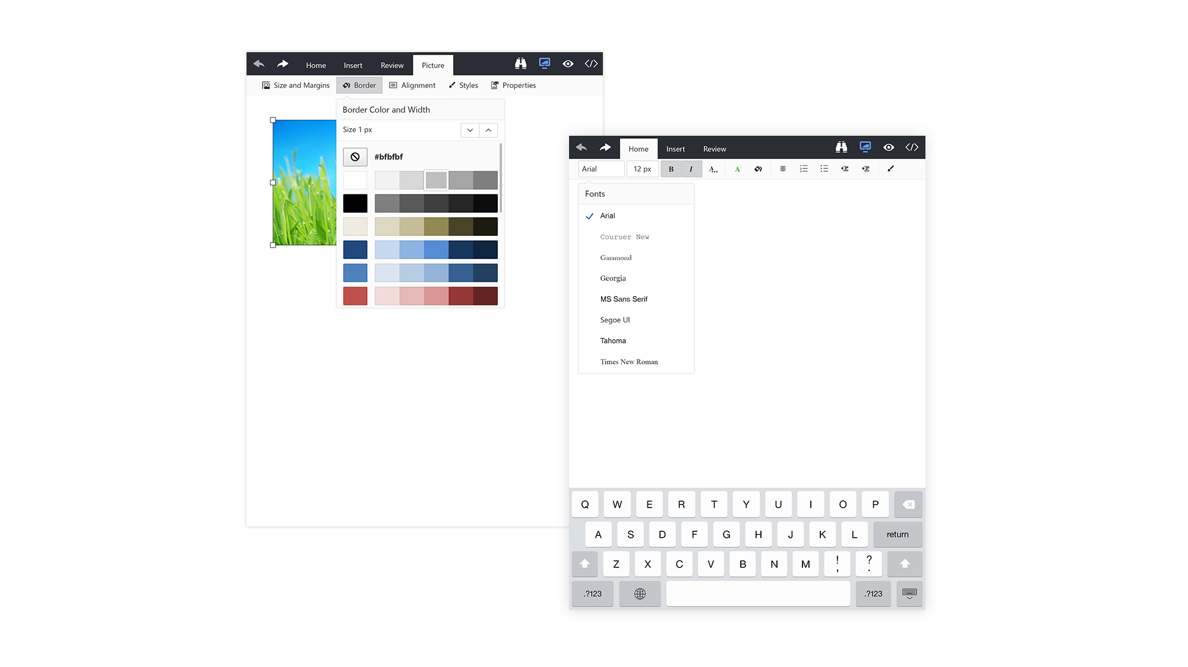

Slide 29
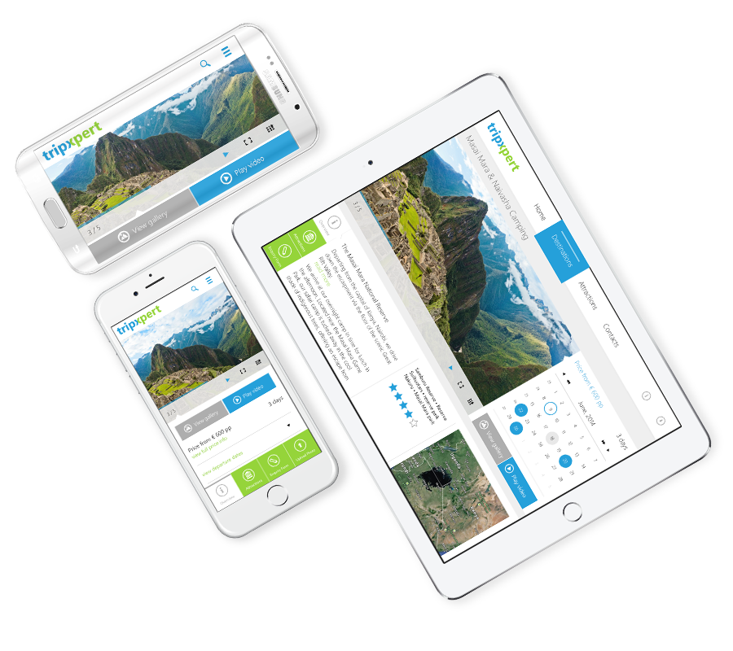
Responsive Web Design
Design and development are based on user experience, screen resolution, device orientation:
fluid grid;
responsive images;
media queries

Slide 30
Fluid Grid

Slide 31
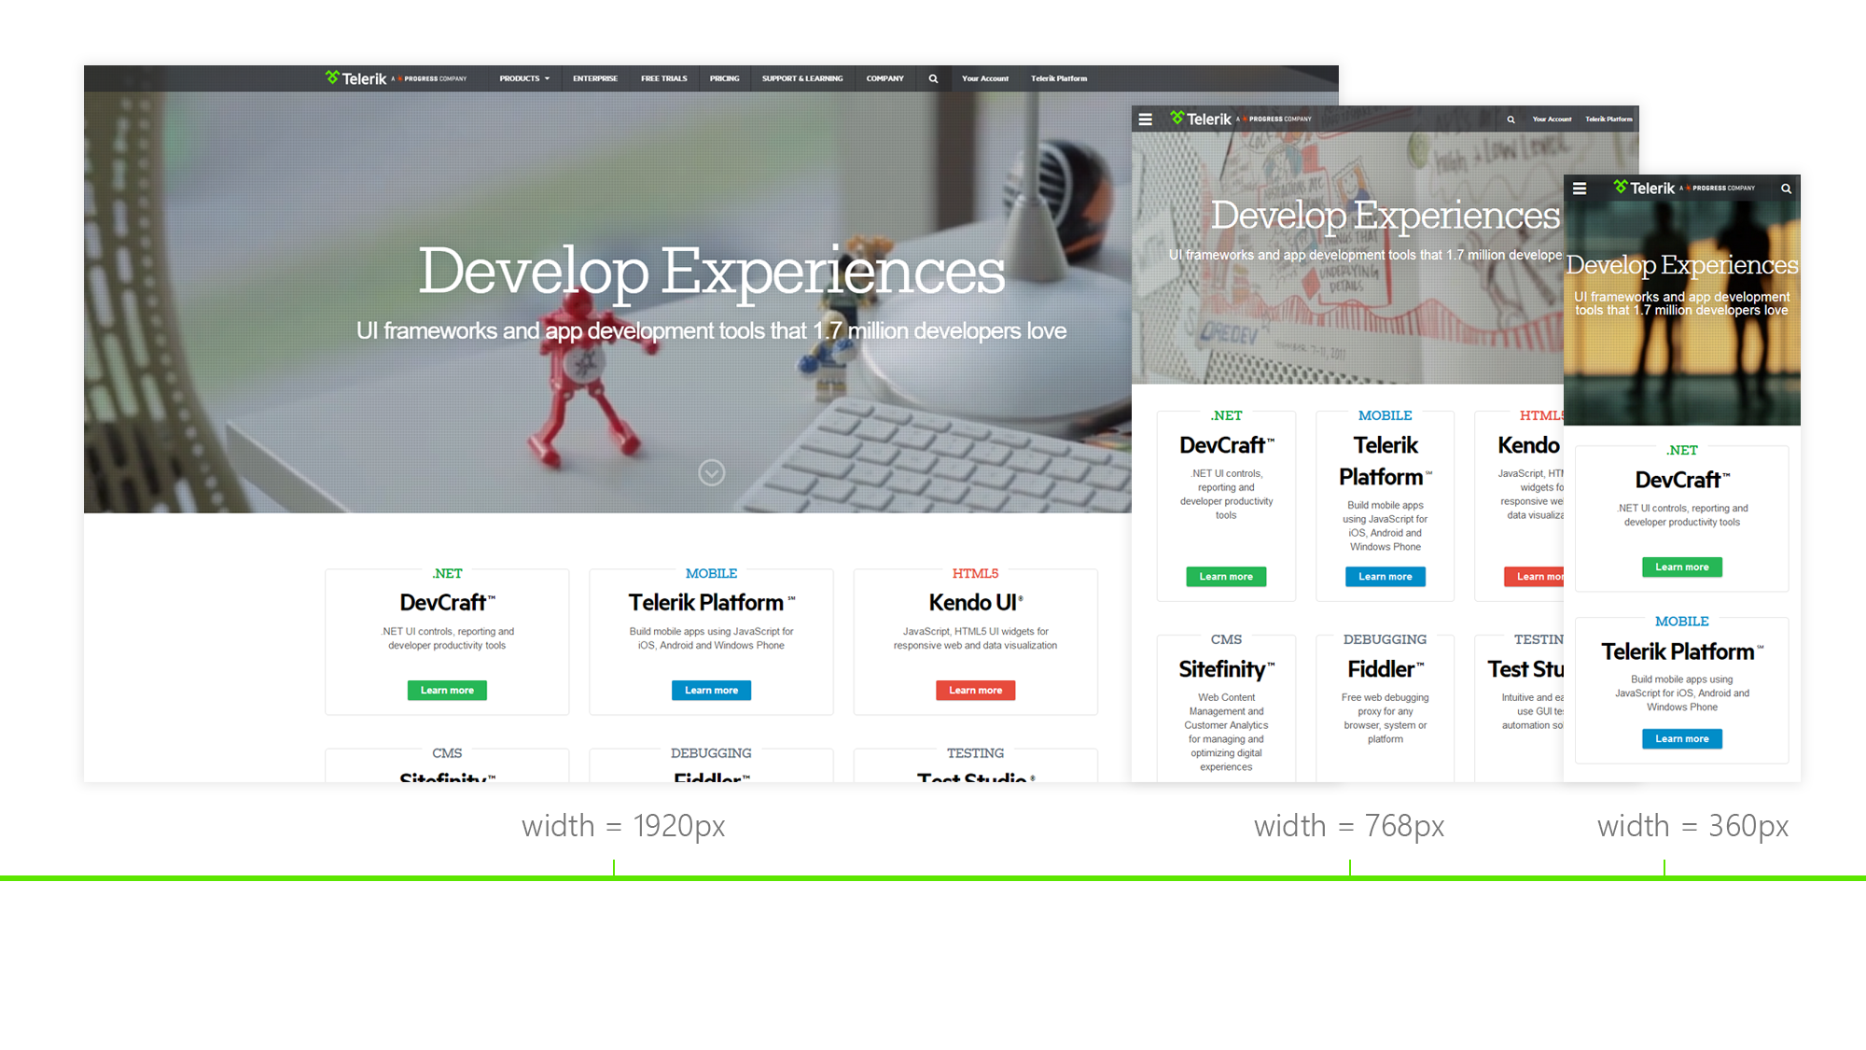

Slide 32
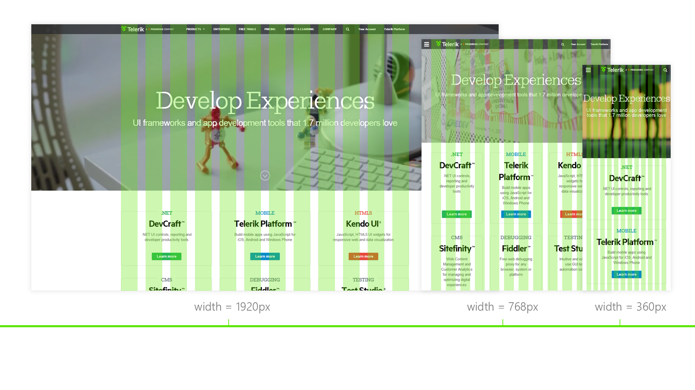

Slide 33
Responsive Images

Slide 34
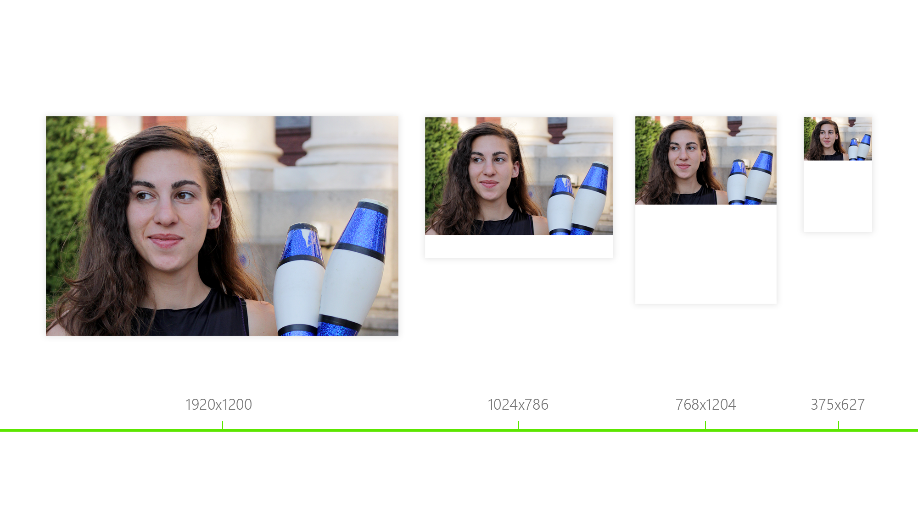
One Image: Width = 100%

Slide 35
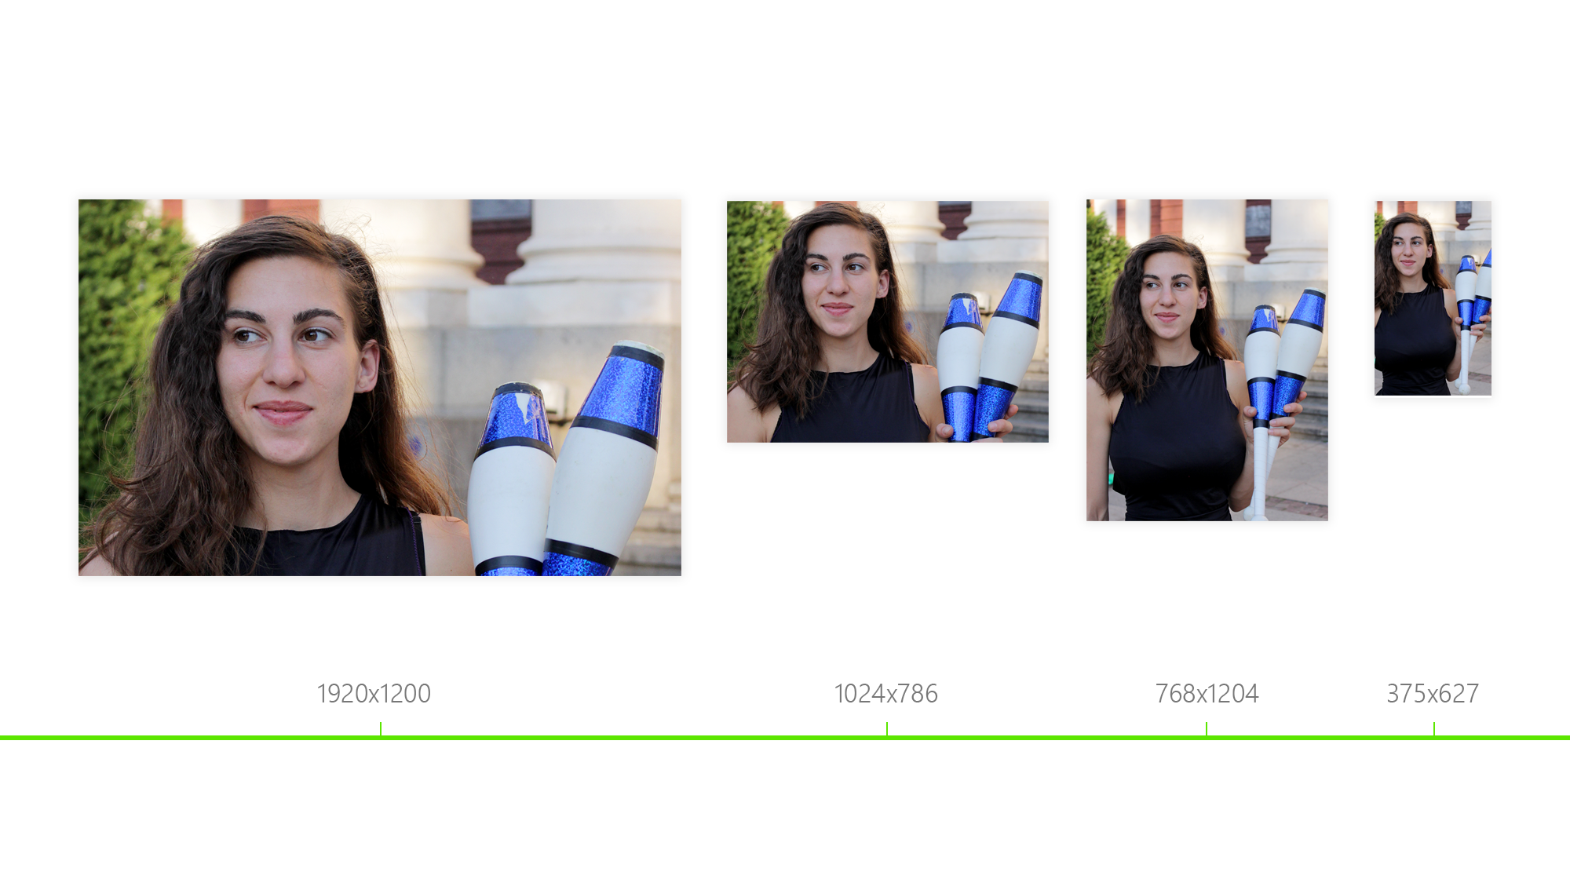
Different Images = srcset

Slide 36
Media Queries

Slide 37
Media Queries
we define criteria for device properties e.g. resolution, orientation
we don't care about the kind of device;
we explore the behavior of the layout on different screen resolutions;
fix it so it runs on all different devices using breakpoints;
we can use it for width, orientation, light level, etc.
available in all modern browsers

Slide 39
RWD
we focus on design and layout;
we create one design to cover all devices;
we cover even the future viewports’ sizes;
we have one code, one deployment and one URL

Slide 40
Telerik UI for ASP.NET AJAX Demos and Sample Applications

Slide 41
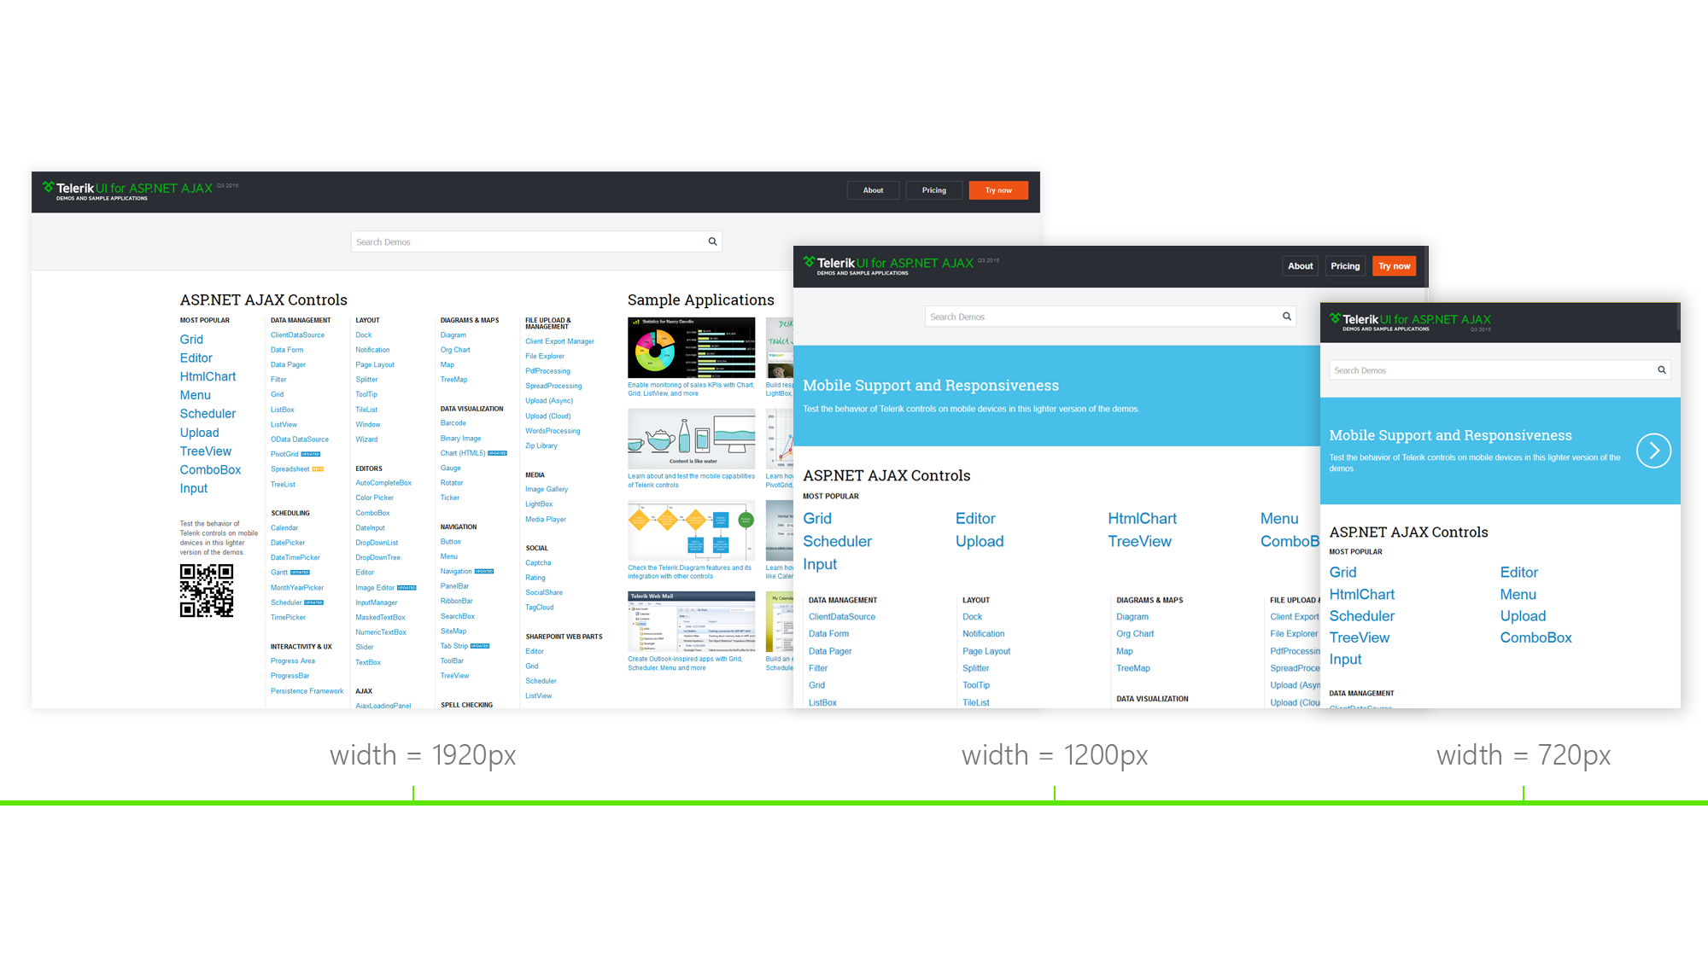

Slide 42
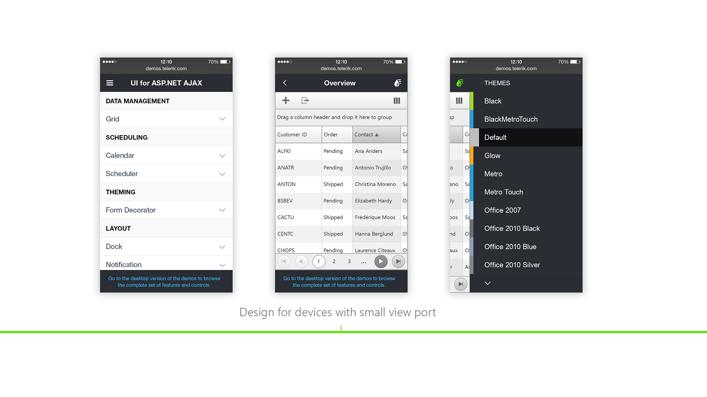

Slide 43
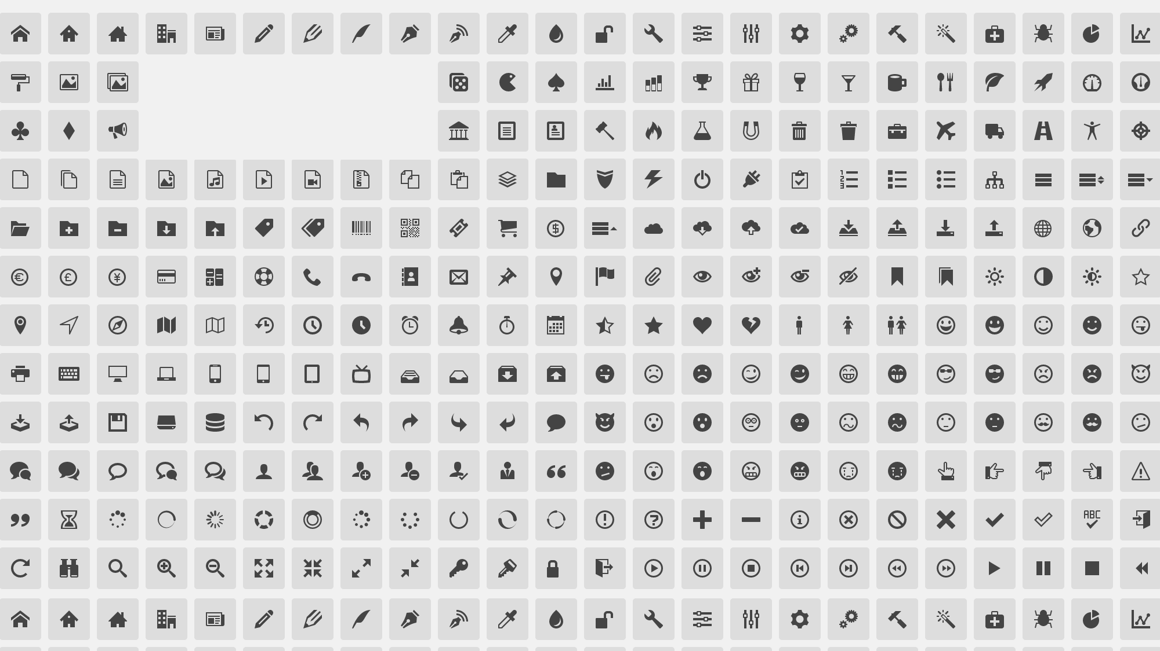
Font Icons

Slide 44
Font Icons
SVG images;
it is easy to change their size;
it is easy to change their color - monochrome based;
they are transparent;
full CSS styling capabilities;
avoid sprite images;
use icon font generator - IconMoon

Slide 45
Do Prototype
go back to drawing;
prepare interactive HTML mock-ups;
divide your project in small steps and test;

Slide 46
Test Before Launching
test your layout not only with clients and colleagues but with friends and family;
prepare list of steps to follow while testing;
be careful for questions like ‘what does this button do?’
be sure the workflow is easy to follow;
give the user little tasks to complete;
ask for feedback

Slide 47

Thank you!
lilia.karakoleva@telerik.com

